Slide 1

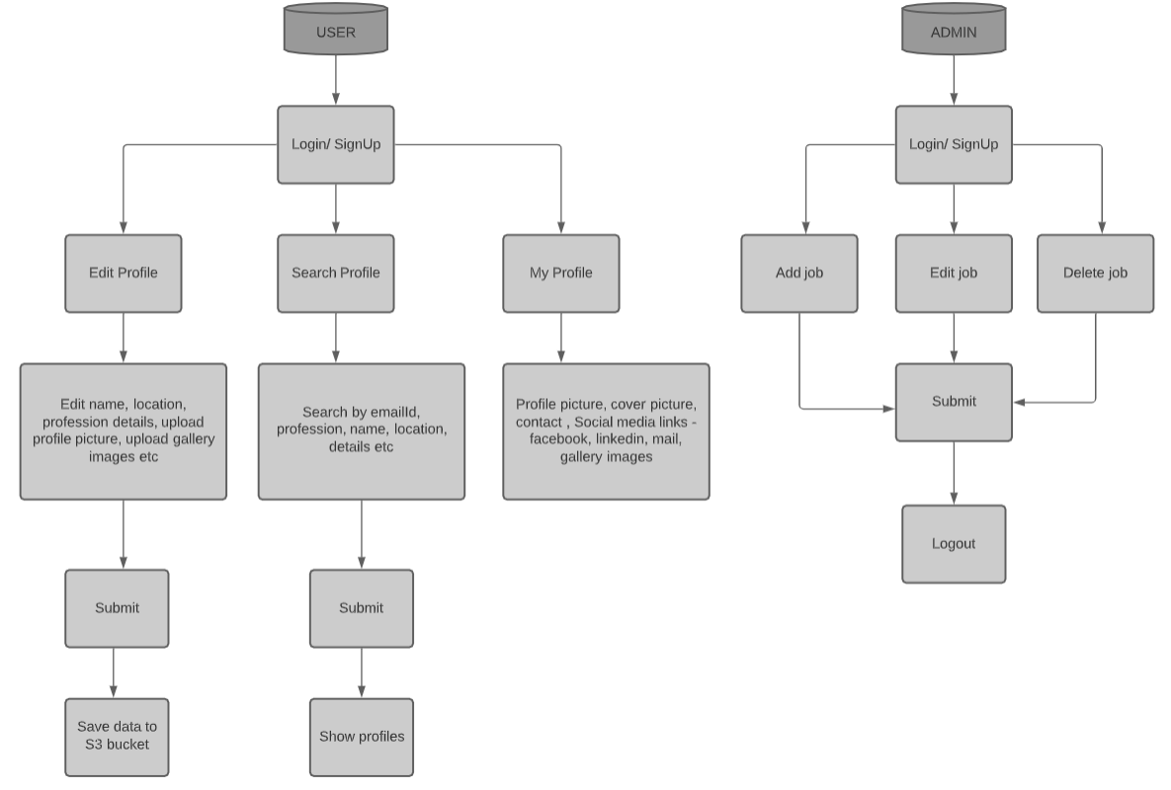
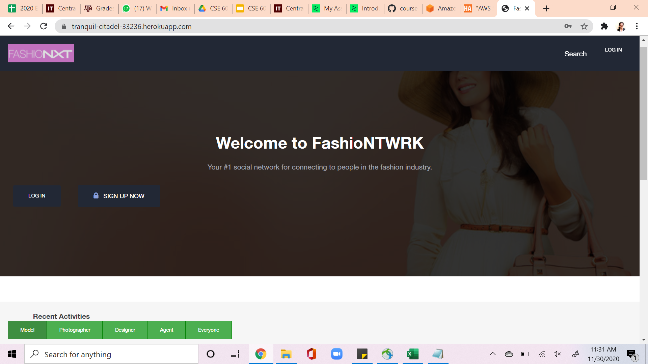
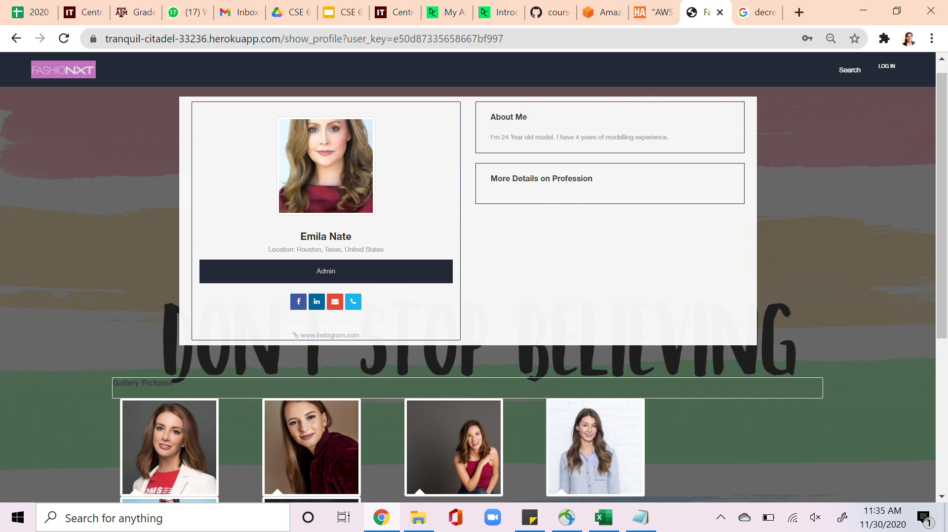
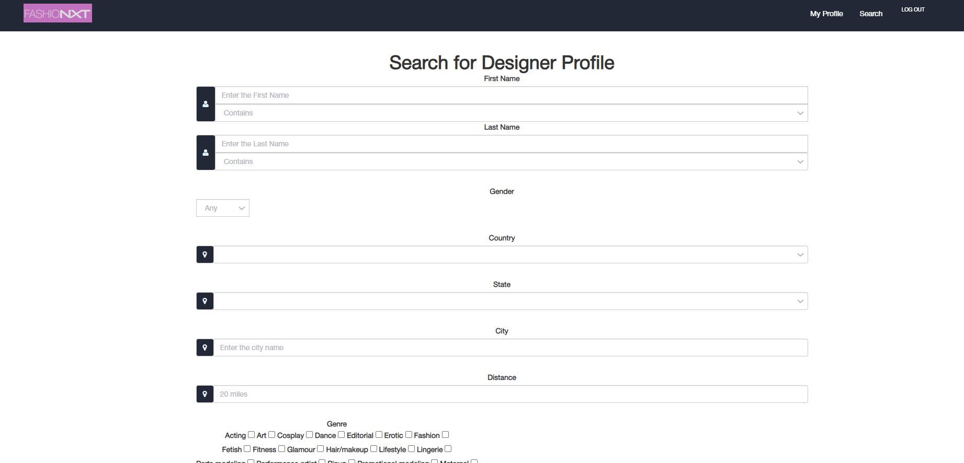
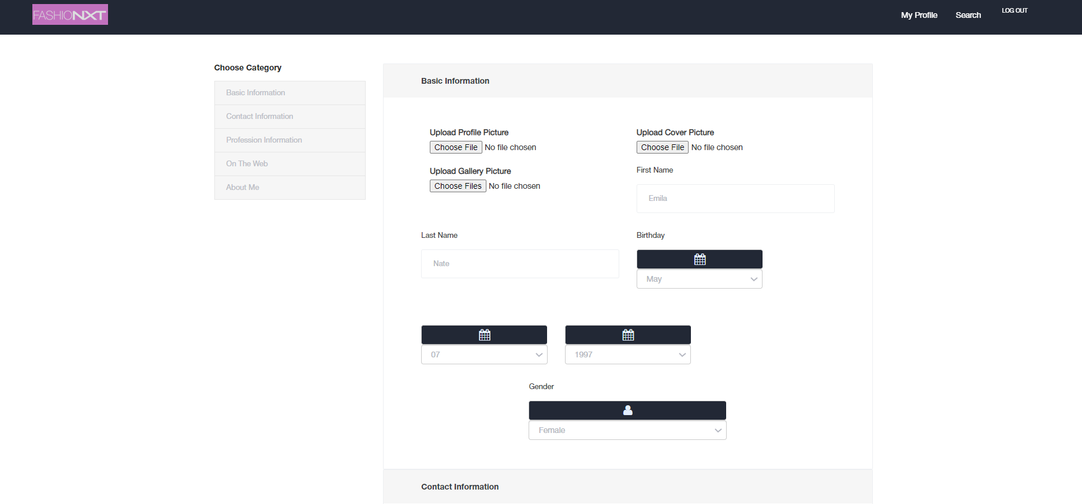
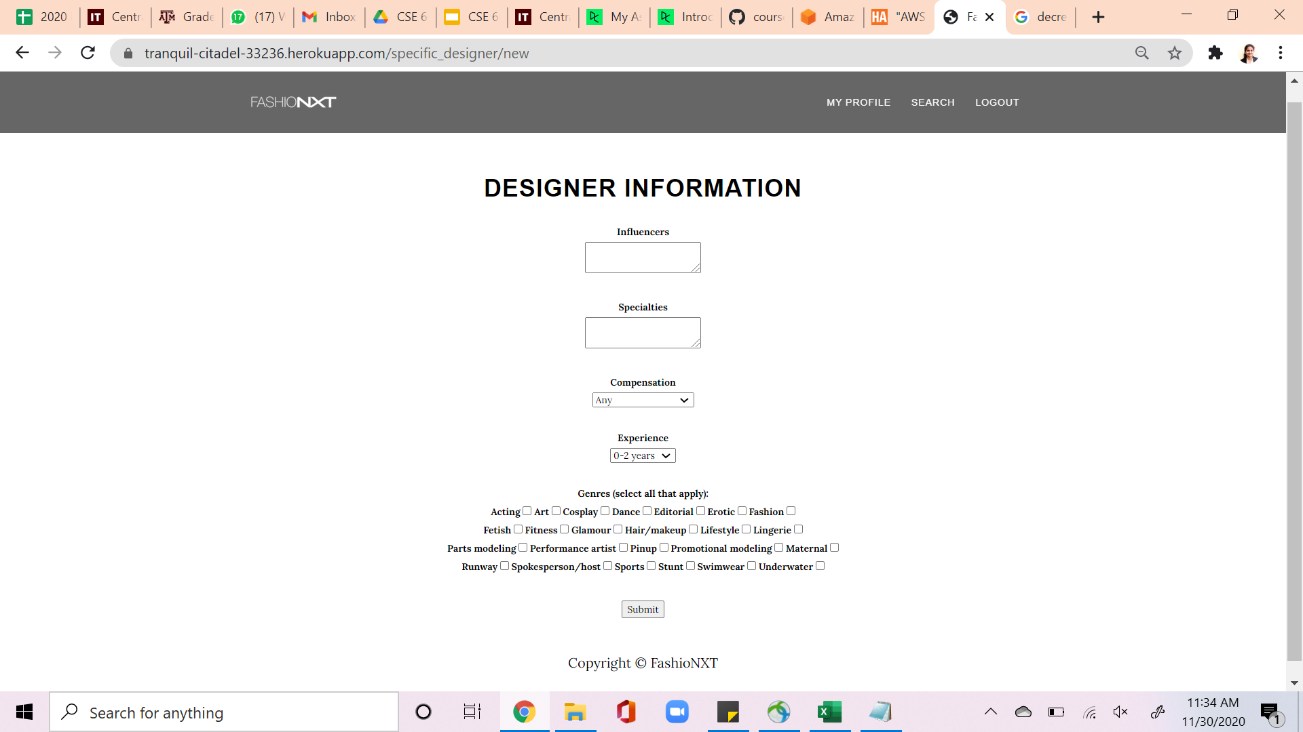
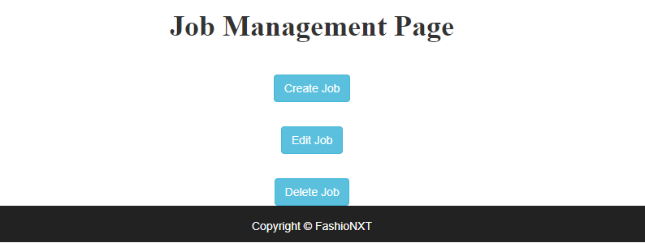
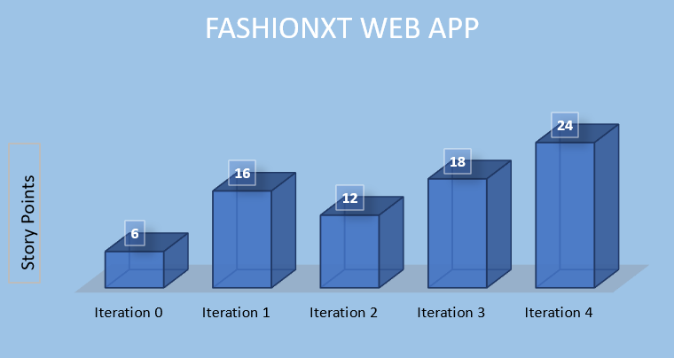
FashioNXT Web Application
Team: Anusha Ravi, Harshvardhan Dewangan, Likhitha Chowdary Paladugu, Manikanta Rajesh Durbha, Mohit Maan, Sumen Mulkiye and Shipra Kushwaha
Department of Computer Science and Engineering, Texas A&M University
CLIENT: Tito Chowdhury, Chief Executive, FashioNXT, Portland, Oregon
Introduction
Design Flow
The primary goal of the project is to allow people in fashion industry to create profiles to show their creative work
The web-based application allows the users to search for the matching profiles based on their job needs in the fashion domain
The application allows admin to add, edit and delete the jobs/professions
Pre-existing features
Before we took up the project, the application had login and signup options
It had a search by name and search by profession feature
The user can upload profile picture and cover picture to his profile and the application had a my profile page to display the profile page of the user
The application didn’t have a cloud database to store the user related information and also had routing issues and some broken links
Application Flow
Home Page / Login Page
User Profile Page
User Stories
User Story 1: Fixing Broken links present at the bottom of pages i.e. Contact Us, Help, Job, About Us
User Story 2: Showing default avatar when user does not choose to upload his/her profile image
User Story 3: Verifying the user email ID & Password strength while sign up
User Story 4: Disabling the Facebook, contact, and LinkedIn icons on the profile page if the user doesn’t provide the links for the respective social media pages
User Story 5: Home page UI changes as requested by the client
User Story 6: Amazon AWS-S3 Bucket connection
User Story 7: Filter the users based on their profession and display them on homepage
User Story 8: Adding Gallery Images and displaying them in a square grid
User Story 9: Admin able to add, edit, and delete jobs/professions
User Story 10: Correcting the broken links and routes from the legacy code
Search Profile Page
Edit Profile Page
Admin Dashboard
Iterations
Velocity Chart
Conclusion
ITERATION 1
USER STORY 1
USER STORY 2
ITERATION 2
USER STORY 3
USER STORY 4
USER STORY 5
Developed a web application that connects people in the fashion industry using Ruby on Rails framework, html, css, and JavaScript. The application is designed to meet the requirements of the client.
References
ITERATION 4
USER STORY 8
USER STORY 9
USER STORY 10
ITERATION 3
USER STORY 6
USER STORY 7
www.freecodecamp.org
www.rubylearning.com
www.fashionmingle.com
www.behance.com
Future Scope
Challenges
Acknowledgement
The application can be further developed by integrating Geolocation API to fine tune the search engine. Features like cropping and editing images can be added. The application can be made mobile friendly.
Since this is a legacy project, setting up the project environment and understanding the code was difficult in the initial phase. Learning and implementing Ruby on Rails at the same time was a little difficult for all the team members.
We would like to thank Prof Dr. Duncan Walker and our client Mr.Tito Choudhary for providing us with clear requirements and clearing our doubts when ever needed. Their extensive support made it possible for us to complete the project.

